Slide 1
Age & Gender Detection
COMPUTER VISION (CS231.M12.KHCL)
Lecture: Mr. MAI TIEN DUNG
Notes:
We designed this template so that each member of the project team has a set of slides with its own theme. Members, here’s how you add a new slide to just your set:
Mark where you want to add the slide: Select an existing one in the Thumbnails pane, click the New Slide button, then choose a layout. The new slide gets the same theme as the other slides in your set.
Careful! Don’t annoy your fellow presenters by accidentally changing their themes. That can happen if you choose a different theme from the Design tab, which changes all of the slides in the presentation to that look.

Slide 2
Team’s Members
Trinh Tuan Nam (19521874) – Face Detection
Nguyen Hoai Nam (18521126) – Age Detection
Nguyen Duong Hai (19521464) – Gender Detection

Slide 3
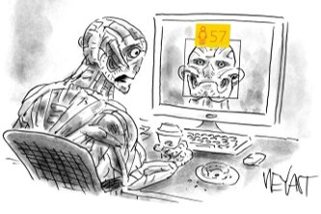
Project Description
How did we detect the face in images ?
How did we detect the gender?
How did we detect the age?
And how well does our model work?

Slide 4
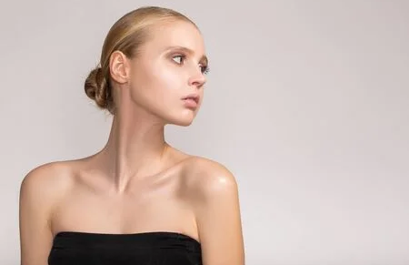
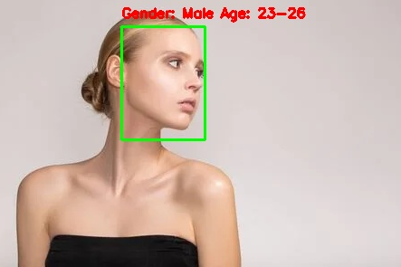

Slide 5
EXPLORATORY DATA ANALYSIS

Slide 6

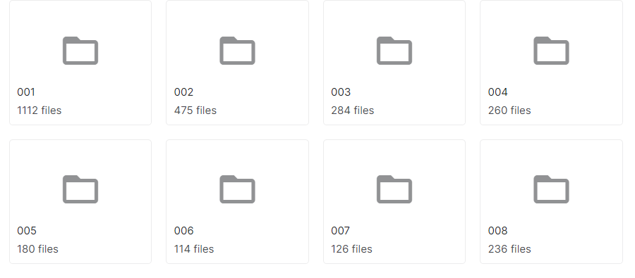


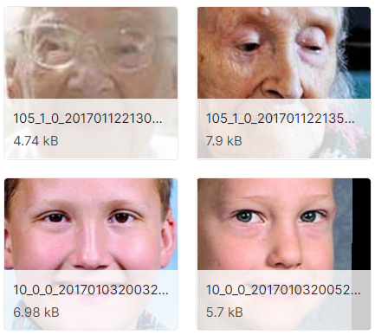
9778 RBG images
PNG format
Size 200x200 pixels
Facial-age
Fazle Rabbi
23708 RBG images
JPG format
Size 200x200 pixels
UTKFace
Sanjaya Subedi
https://www.kaggle.com/frabbisw/facial-age
https://www.kaggle.com/jangedoo/utkface-new

Slide 7
DATASET PREPARATION

Slide 8

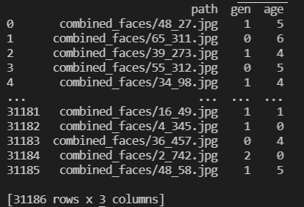
Convert all images to the same JPG format, size: (200, 200)
20%
Combined
datasets
20%
80%

Slide 9
PART 1: FACE DETECTION

Slide 10
Research methods:
Haar cascade
MTCNN
YOLOV4 for object detection

Slide 11

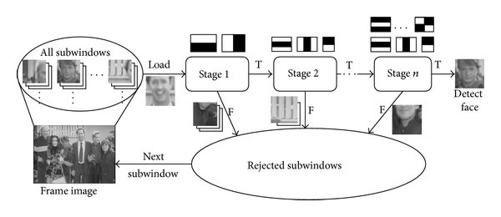
HAAR CASCADE
Released in 2001.
Haar Features.
Adaboots.
- Choose the best features.
- Powerful classifier training: linear combination of weaker classifiers.

Slide 12
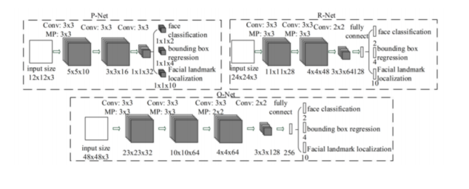
MTCNN
Stage 1 : P-Net
Stage 2 : R-Net
Stage 3 : O-Net
P-Net: Predict areas in an image that could be faces.
R-Net: Use the output of P-Net to remove areas that are not faces.
O-Net: Use the output of R-Net to give the final result along with 5 facial landmarks (2 eyes, nose, 2 corners of mouth).

Slide 13
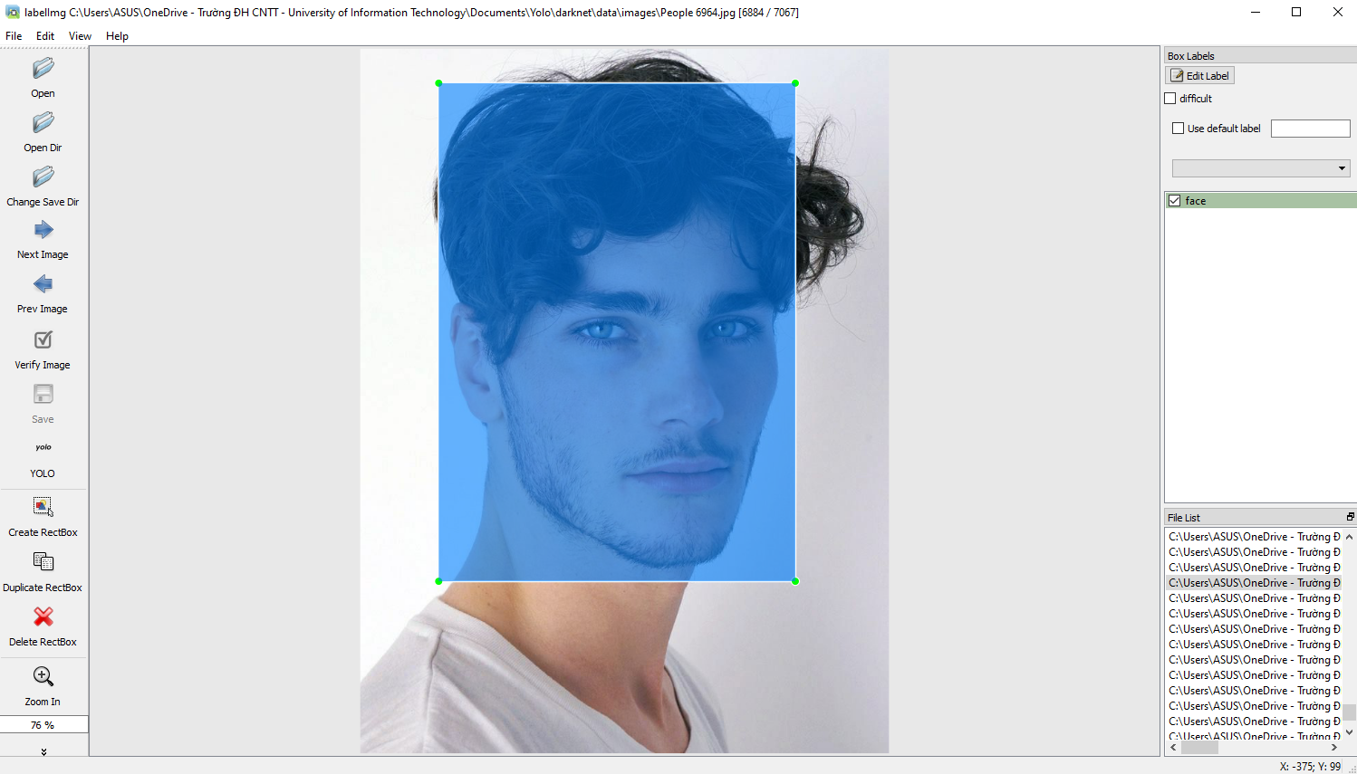
YOLOV4 FOR OBJECT DETECTION
DATA
TRANING
Dataset: https://www.kaggle.com/ashwingupta3012/human-faces

Slide 14
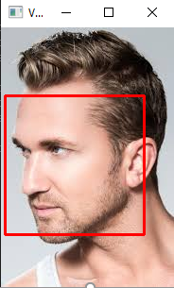
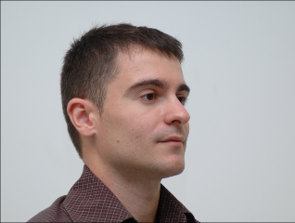
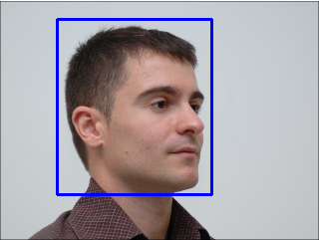
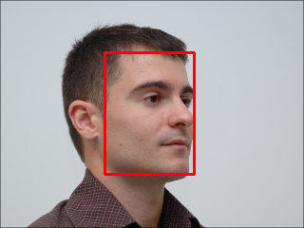

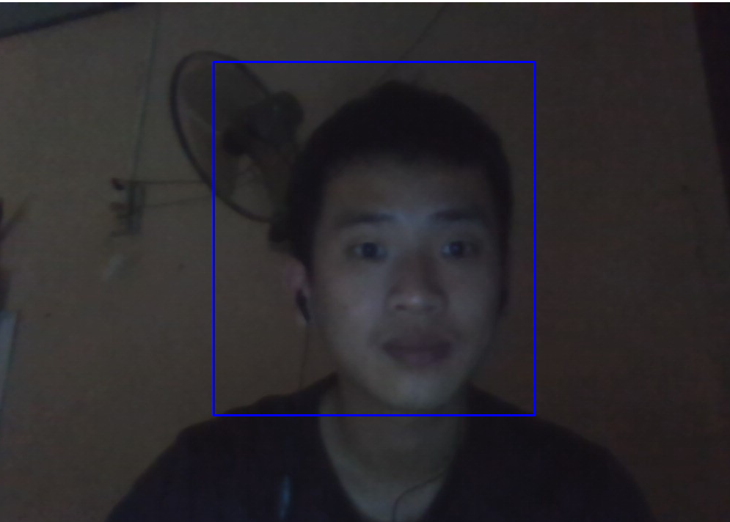
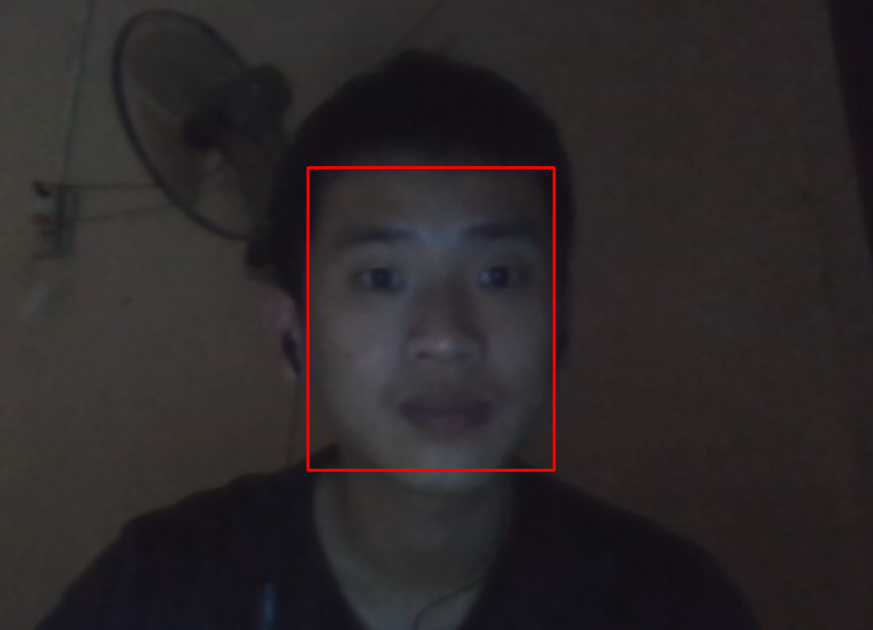
COMMENT
Haar Cascade
The fastest Works well with frontial face Easily affected by environmental light
YOLO
2nd fastest Works well even in case of missing, obscured faces Less affected by ambient light
MTCNN
3rd fastest Works well even in TH missing, obscured faces Less affected by ambient light

Slide 15
Documents:
https://www.miai.vn/2019/08/09/yolo-series-2-cach-train-yolo-de-detect-cac-object-dac-thu/
https://github.com/ipazc/mtcnn
https://viblo.asia/p/nhan-dien-khuon-mat-voi-mang-mtcnn-va-facenet-phan-1-Qbq5QDN4lD8
https://towardsdatascience.com/face-detection-using-mtcnn-a-guide-for-face-extraction-with-a-focus-on-speed-c6d59f82d49
https://viblo.asia/p/tim-hieu-ve-yolo-trong-bai-toan-real-time-object-detection-yMnKMdvr57P
https://www.miai.vn/2020/05/25/yolo-series-train-yolo-v4-train-tren-colab-chi-tiet-va-day-du-a-z/
https://towardsdatascience.com/yolov4-in-google-colab-train-your-custom-dataset-traffic-signs-with-ease-3243ca91c81d
https://viblo.asia/p/haar-cascade-la-gi-luan-ve-mot-ky-thuat-chuyen-dung-de-nhan-biet-cac-khuon-mat-trong-anh-E375zamdlGW
https://docs.opencv.org/3.4/db/d28/tutorial_cascade_classifier.html
https://www.pyimagesearch.com/2021/04/12/opencv-haar-cascades/

Slide 16
PART 2: AGE DETECTION

Slide 17
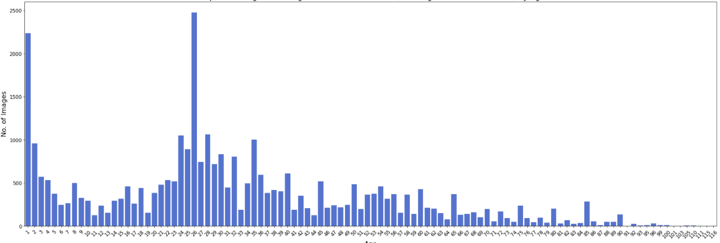
Data Preprocessing
Combined datasets

Slide 18
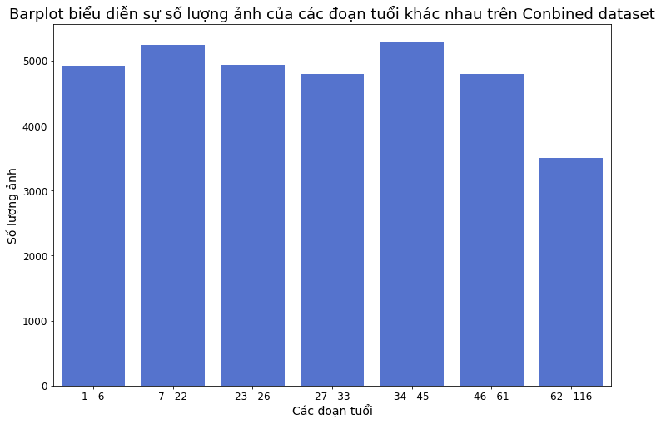
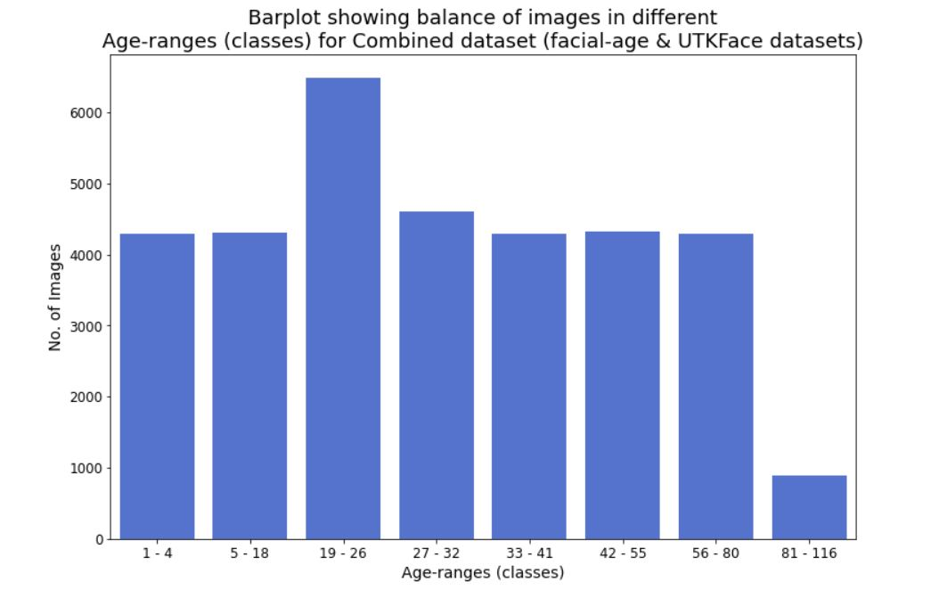
Split data into classes of age-ranges
7 classes
8 classes

Slide 19
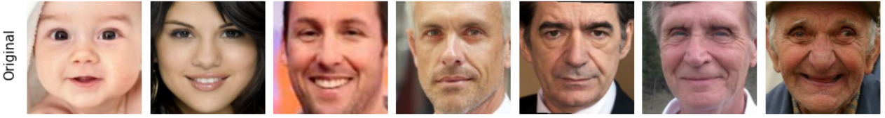
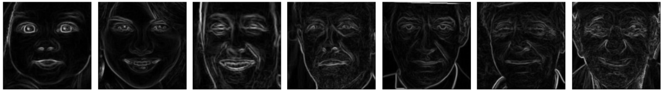
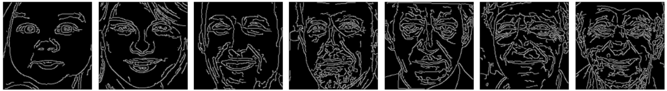
Feature Extraction
Original
Sobel
Canny
- https://colab.research.google.com/drive/1_KY0pt7G7mNg_7BiSbf_2ErUFqAQ4pNd#scrollTo=JgWbwm2uyH1V
- https://www.ijert.org/research/comparison-of-canny-edge-detector-with-sobel-and-prewitt-edge-detector-using-different-image-formats-IJERTCONV2IS03009.pdf

Slide 20
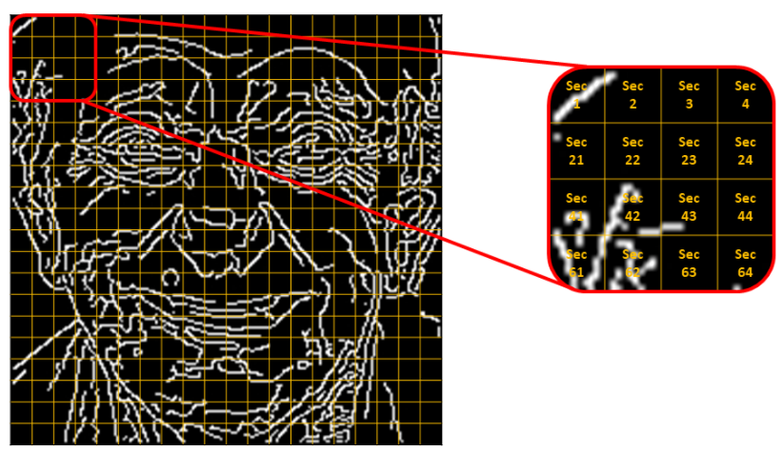
200
10
mean value
10
200
std (standard deviation) value
- https://colab.research.google.com/github/kozodoi/website/blob/master/_notebooks/2021-03-08-image-mean-std.ipynb#scrollTo=CIYKt5CQDILS

Slide 21
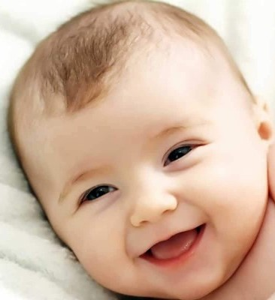
1 - 6
64 - 116

Slide 22
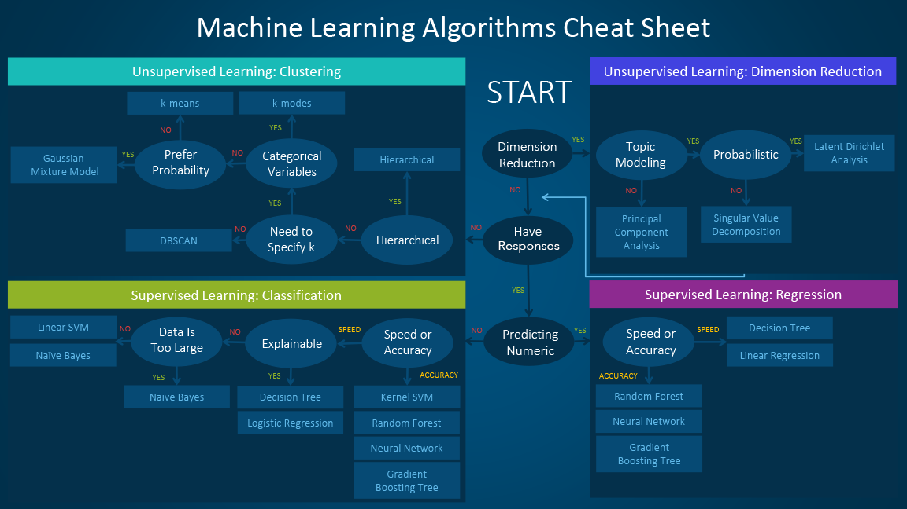
- https://blogs.sas.com/content/subconsciousmusings/2020/12/09/machine-learning-algorithm-use/

Slide 23
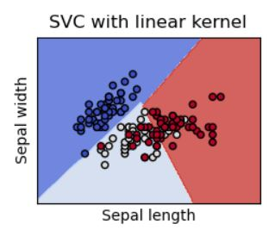
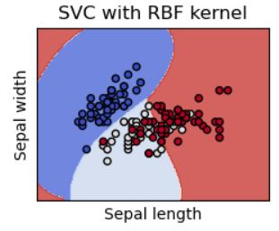
KERNEL
104 classes
LINEAR
RBF
TRAINING ACC
96.8%
65.8%
TESTING ACC
44.8%
30.7%
KERNEL
7 classes
LINEAR
RBF
TRAINING ACC
60.8%
84.8%
TESTING ACC
46.8%
56.1%

Slide 24
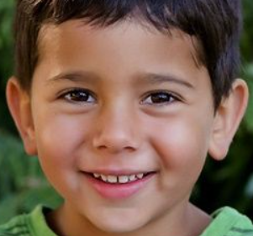
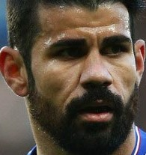
1 - 6
64 - 116
27

Slide 25
PART 3: GENDER DETECTION

Slide 26
Research methods:
Supported Vector Machine (SVM)
Convolutional Neural Network (CNN)

Slide 27
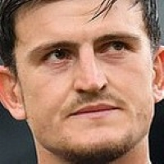
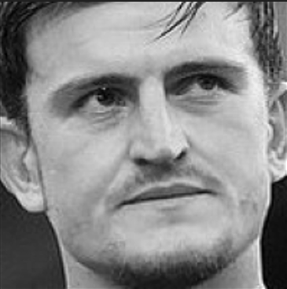
Supported Vector Machine (SVM)
np.array(img).ravel()
[75 11 ... 7 5]
Shape: (40000,1)
(200, 200) img
img to binary

Slide 28
Data Preprocessing
X_train (2D)
[[0.2941 0.2941 ... 0.0274 0.0196]
[0.9094 0.9092 ... 0.7815 0.8967]
...
[0.0845 0.0845 ... 0.5956 0.5882]
[0.2274 0.2823 ... 0.0235 0.0078]]
imgs_feature
np.array(imgs_feature)
/255.0
gender
1
0
2
1
1
…
0: female
1: male
2: unknown
np.array(df_train['gender'])
[1 0 2 1 1 … 1 0 1 1 2]
y_train
df_train['gender']

Slide 29
Training Model
from sklearn.svm import SVC
model = SVC(kernel=‘rbf’)
model.fit(X_train, y_train)
model_SVM.sav

Slide 30
Convolutional Neural Network (CNN)
[[75 11 ... 7 5 ]
[51 87 ... 8 7 ]
...
[17 28 ... 9 5 ]
[44 58 ... 7 4 ]]
np.array(img)
(200, 200) img
img to binary
Shape: (200,200)

Slide 31
Data Preprocessing
X_train (3D)
[[[0.2941 0.2941 ... 0.0274 0.0196]
...
[0.2274 0.2823 ... 0.0235 0.0078]]
...
[[0.0588 0.0431 ... 0.0352 0.0196]
...
[[0.1647 0.2274 ... 0.0274 0.0078]]]
imgs_feature
np.array(imgs_feature)
/255.0
gender
1
0
2
1
1
…
0: female
1: male
2: unknown
Reshape to 4D array
[[0. 1. 0.]
[1. 0. 0.]
…
[0. 1. 0.]
[0. 0. 1.]]
np.array(df_train['gender’])
[1 0 2 1 1 … 1 0 1 1 2]
one_hot()
y_train
df_train['gender']

Slide 32
Model: "sequential“
_________________________________________________________________
Layer (type) Output Shape Param #
=================================================================
conv2d (Conv2D) (None, 198, 198, 16) 160
max_pooling2d (MaxPooling2D) (None, 99, 99, 16) 0
conv2d_1 (Conv2D) (None, 97, 97, 32) 4640
max_pooling2d_1 (MaxPooling2D) (None, 48, 48, 32) 0
conv2d_2 (Conv2D) (None, 46, 46, 32) 9248
max_pooling2d_2 (MaxPooling2D) (None, 23, 23, 32) 0
conv2d_3 (Conv2D) (None, 21, 21, 64) 18496
max_pooling2d_3 (MaxPooling2D) (None, 10, 10, 64) 0
conv2d_4 (Conv2D) (None, 8, 8, 64) 36928
max_pooling2d_4 (MaxPooling2D) (None, 4, 4, 64) 0
flatten (Flatten) (None, 1024) 0
dense (Dense) (None, 128) 131200
dense_1 (Dense) (None, 3) 387
=================================================================
Total params: 201,059
Trainable params: 201,059
Non-trainable params: 0

Slide 33
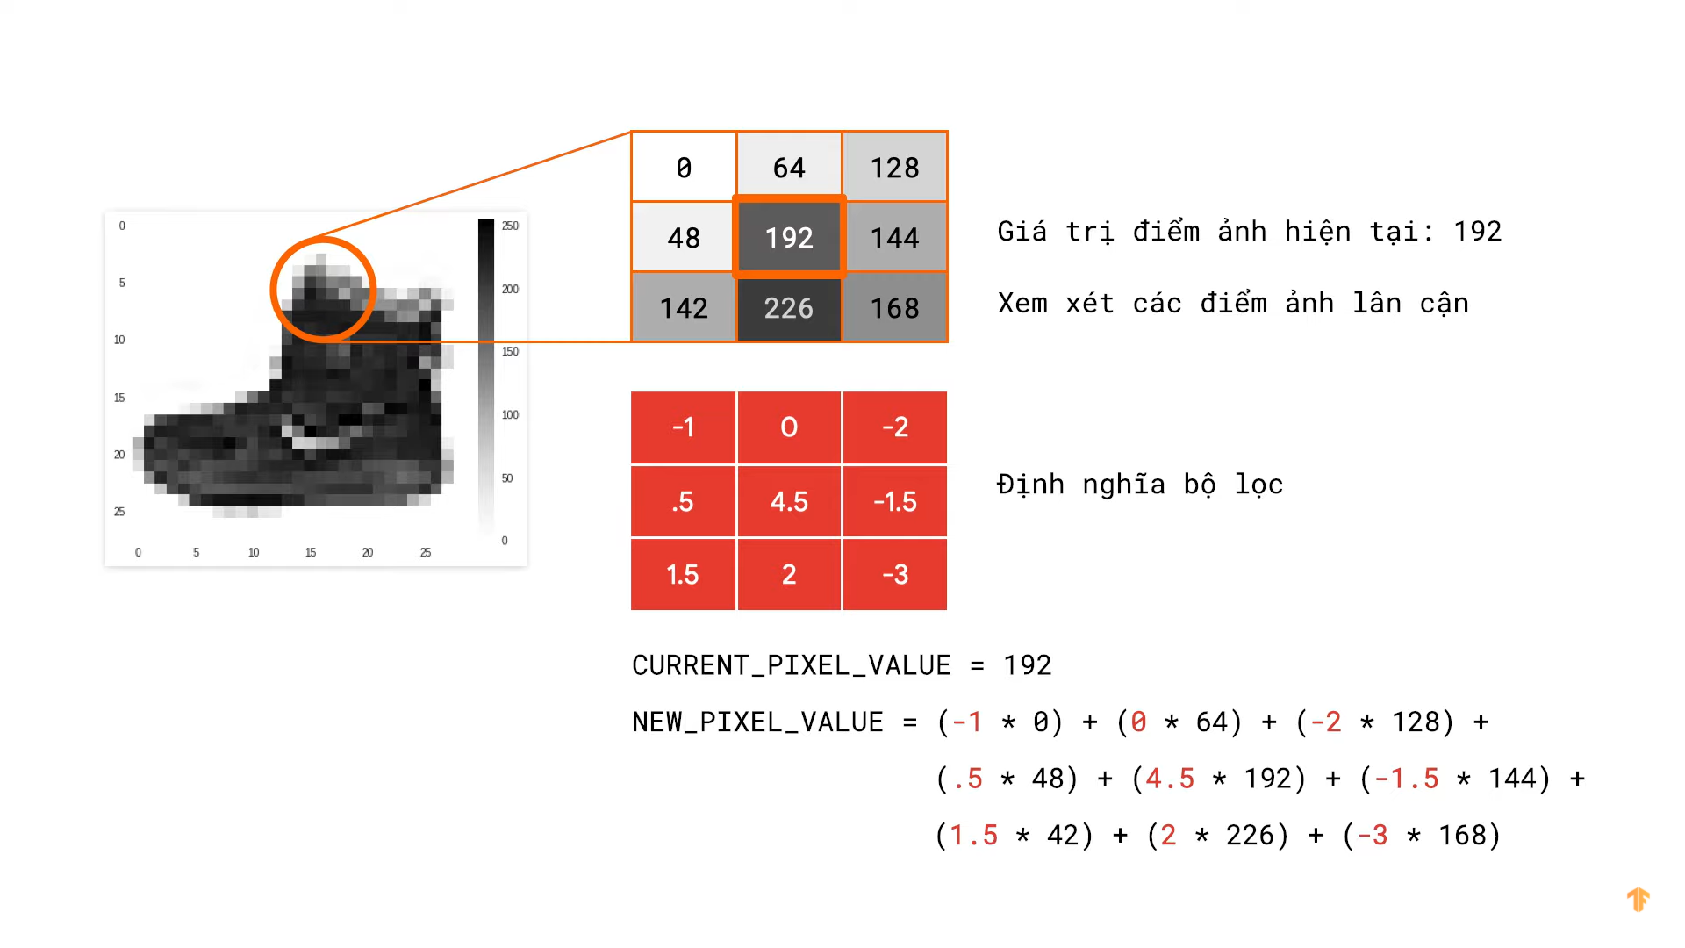
CONV2D
Current pixel value
Filter
https://www.youtube.com/watch?v=56ri8v5fM_w&t=272s

Slide 34
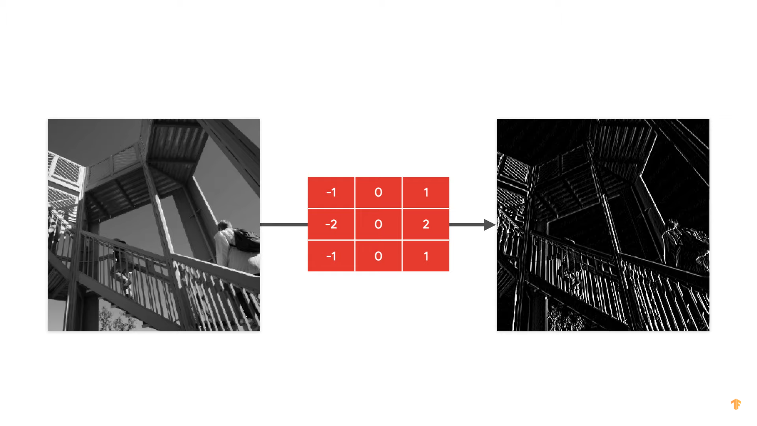
CONV2D
https://www.youtube.com/watch?v=56ri8v5fM_w&t=272s

Slide 35
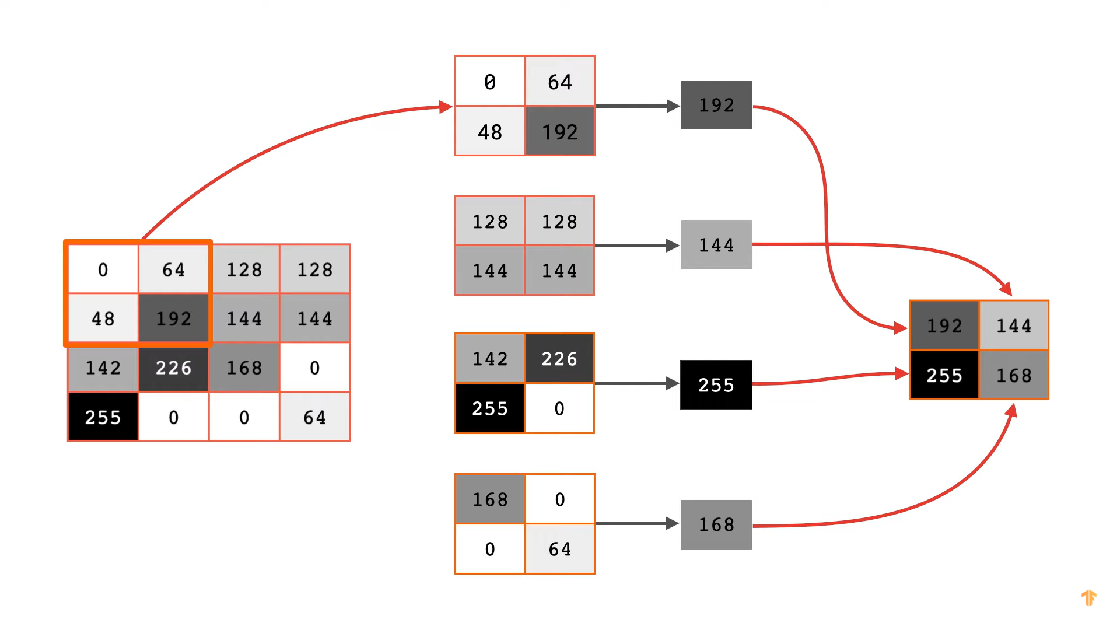
MAXPOOLING2D
https://www.youtube.com/watch?v=56ri8v5fM_w&t=272s

Slide 36
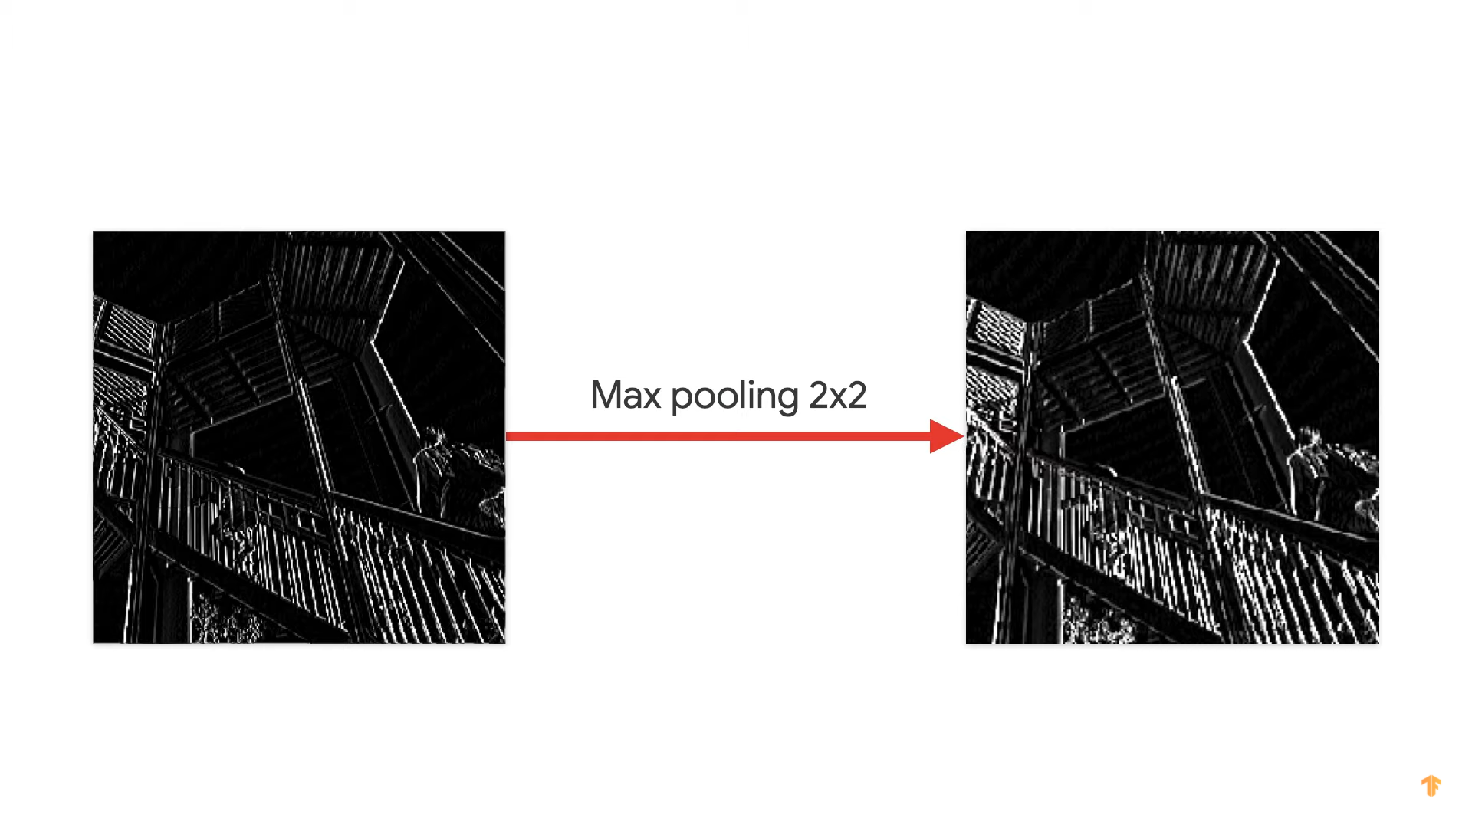
MAXPOOLING2D
1/4
https://www.youtube.com/watch?v=56ri8v5fM_w&t=272s

Slide 37
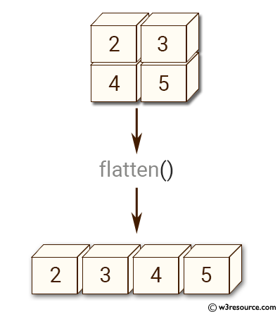
FLATTEN
1/4
https://www.w3resource.com/numpy/manipulation/ndarray-flatten.php

Slide 38
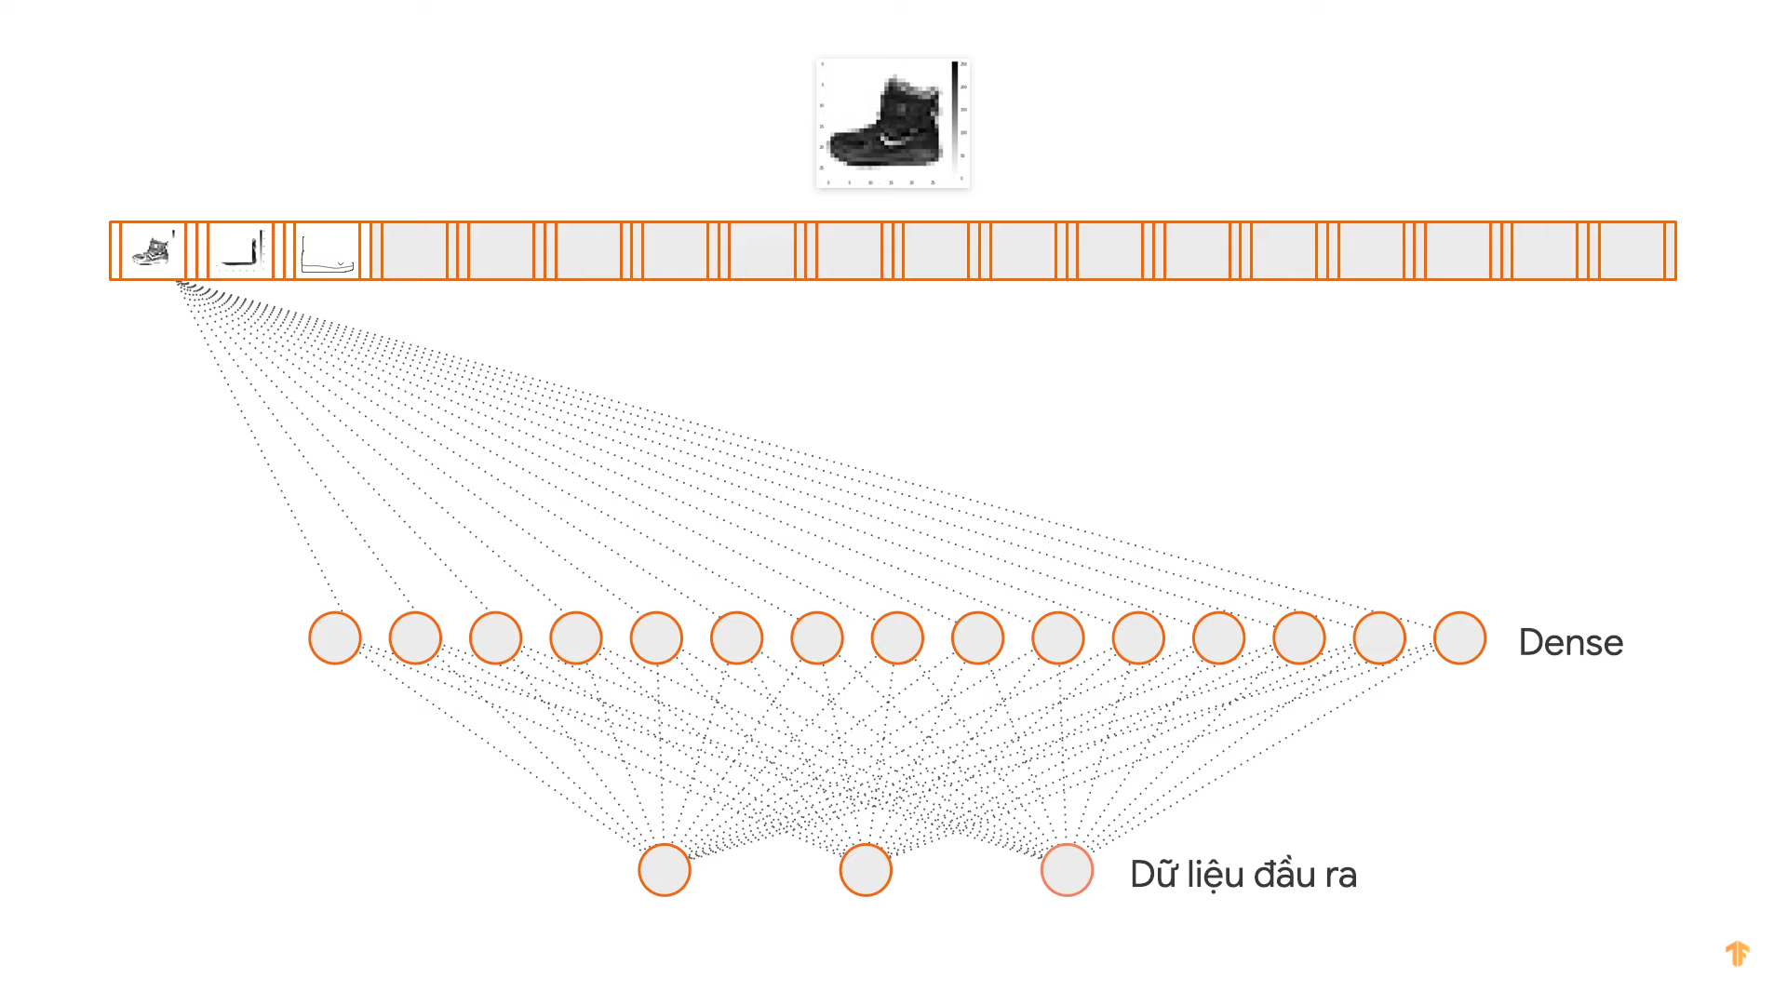
DENSE
Output
https://www.youtube.com/watch?v=56ri8v5fM_w&t=272s

Slide 39
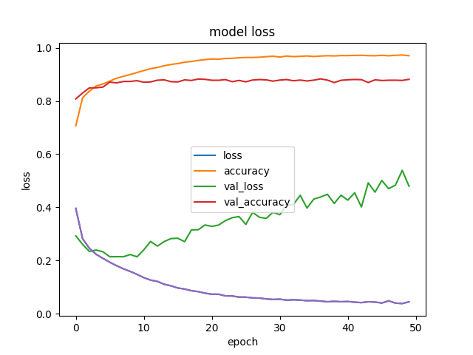
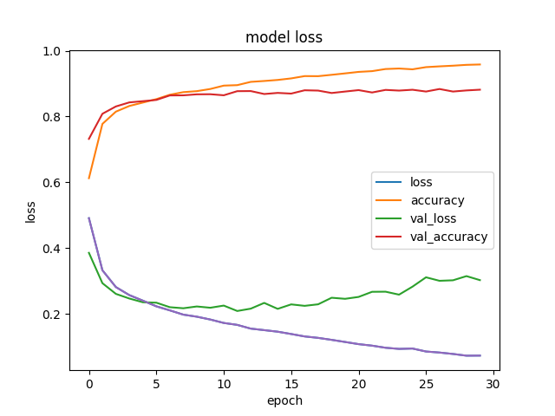
Training Model
model
compile and fit
model_CNN.h5
50 epochs
30 epochs
-- Test Accuracy: 88.32 %
-- Test Loss: 0.42316874523015
-- Test Accuracy: 88.06 %
-- Test Loss: 0.3133225440979004

Slide 40

Predict and Comment
SVM (kernel=‘rbf’)
Accuracy: 83.85 % Slowly predict and less accurate
CNN
Accuracy: 88.06 % Predict faster and more accurate
predict
0 0 2 1 1 2
0 0 0 1 1 2
true
0 0 0 1 1 0
0 0 0 1 1 0
https://www.kaggle.com/depekha/gender-and-age-detection

Slide 41
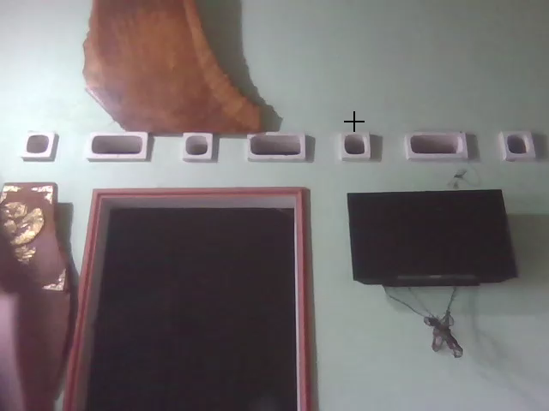
DEMO in real-time
41

Slide 42
THANK YOU !

